Slide 1
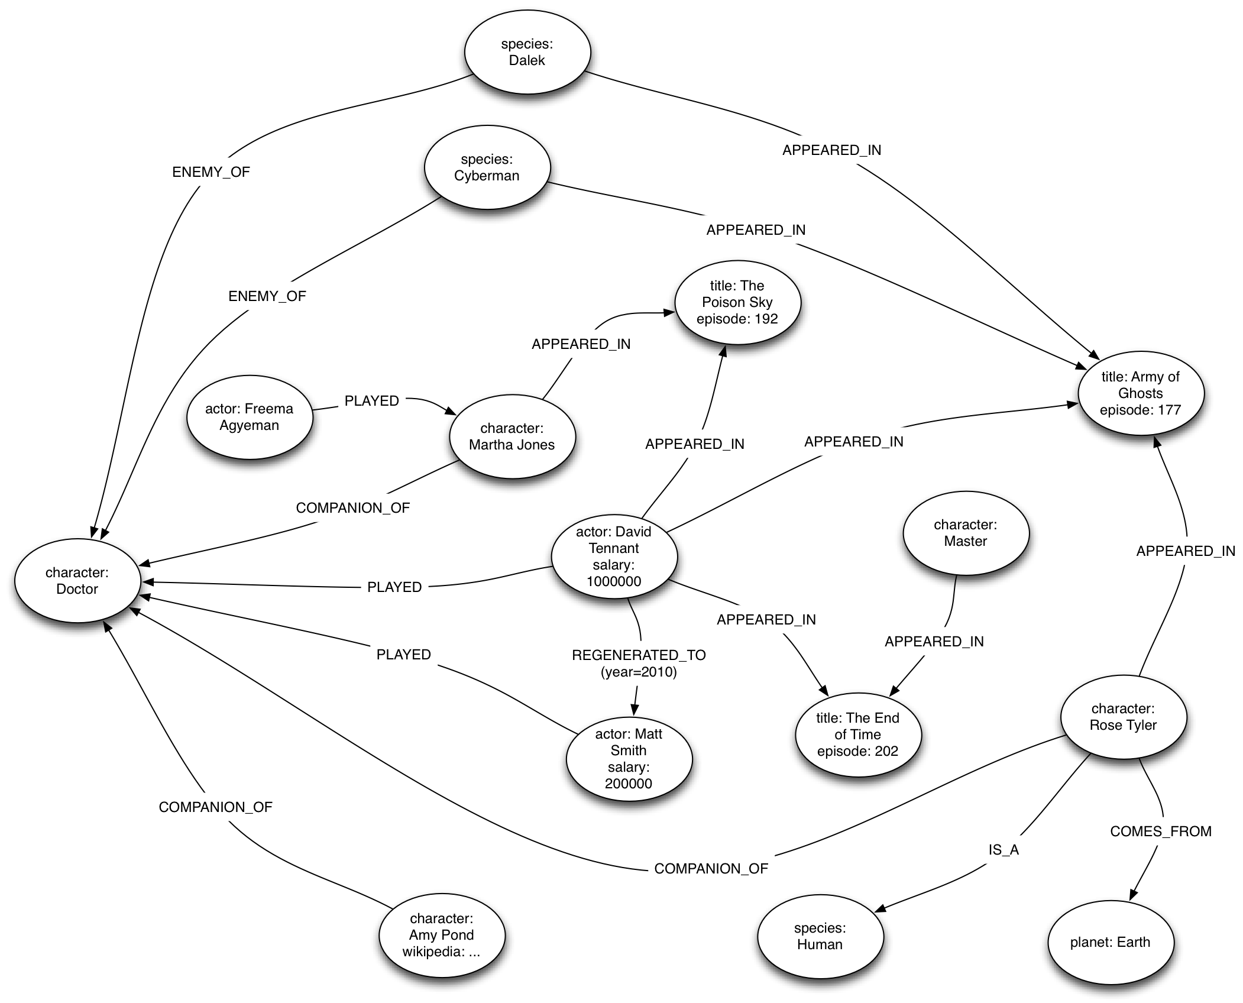

Slide 2
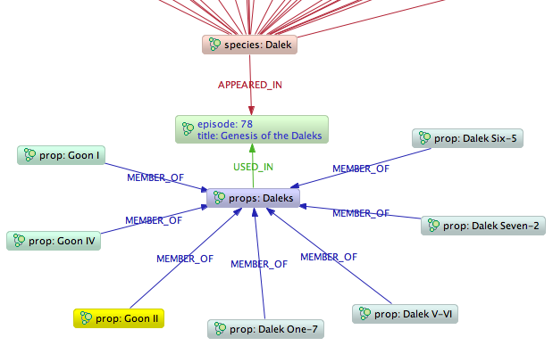
Dalek Props

Slide 3
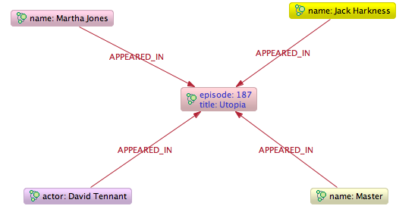
Episodes Containing David Tennant and The Master

Slide 4
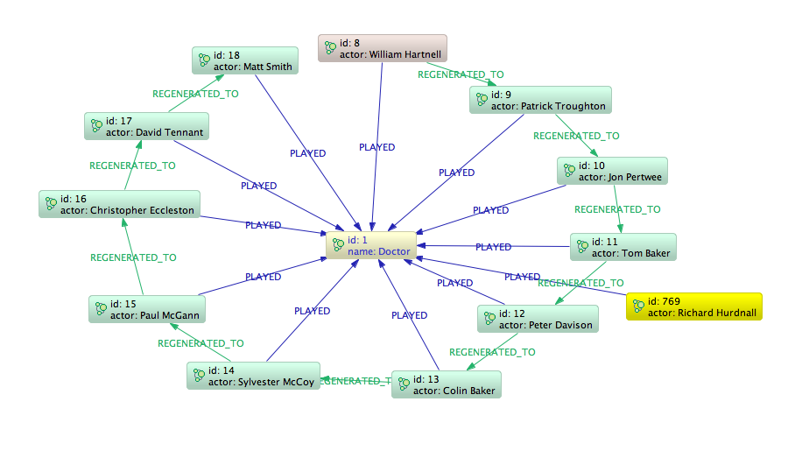
The Doctor Regenerates

Slide 5
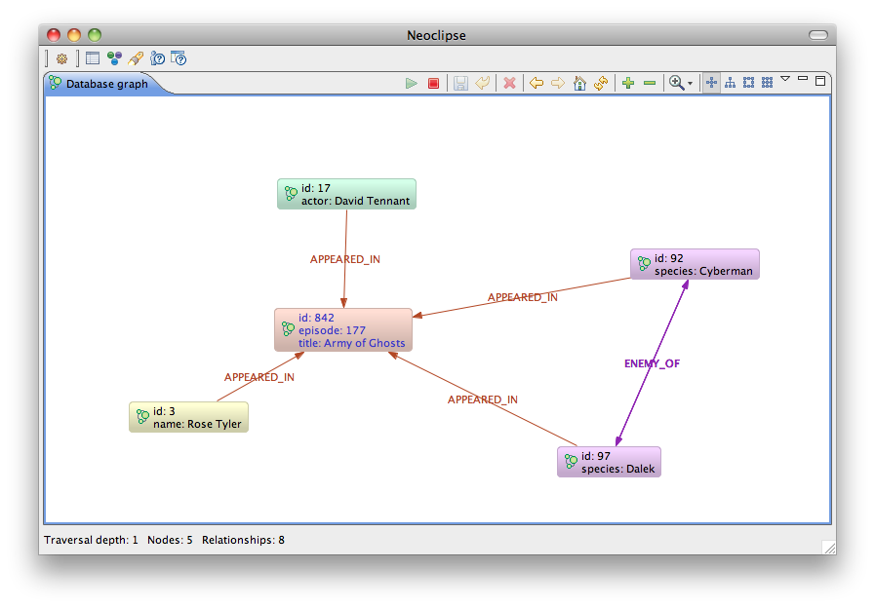
Episodes Where Rose Battled The Daleks

Slide 6
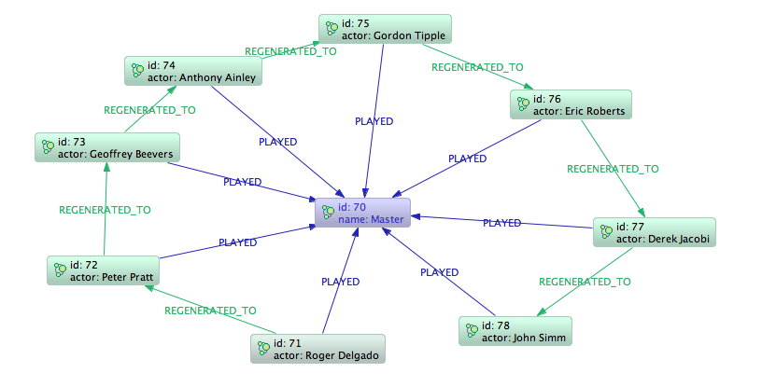
The Master Regenerates

Slide 7
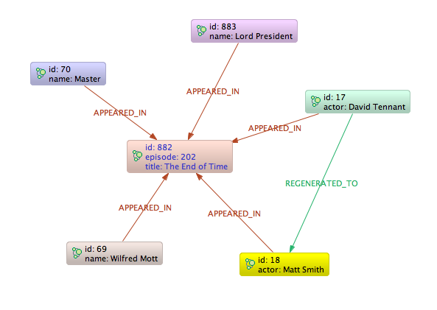
David Tennant Regenerates

Slide 8
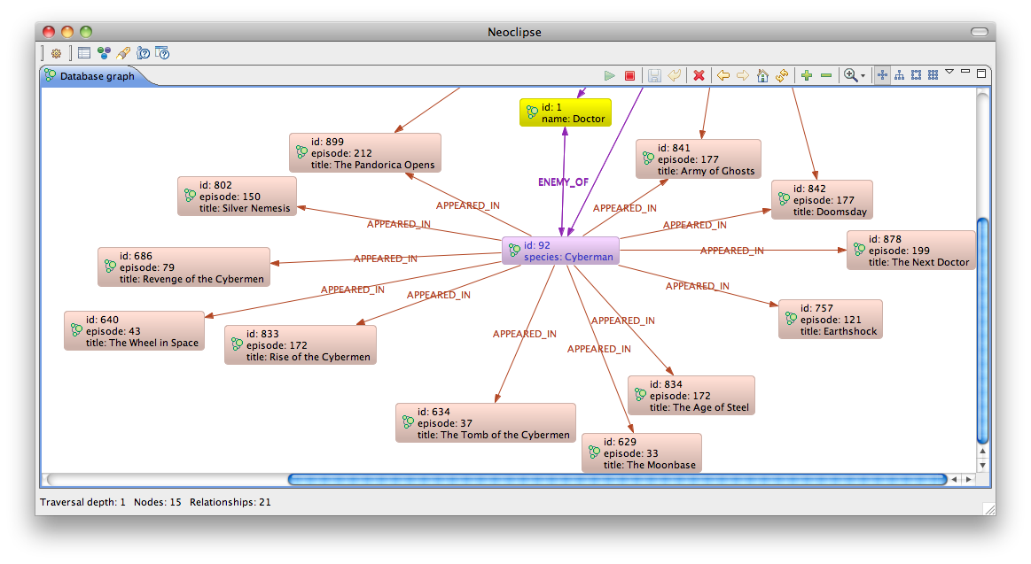
Episodes Where The Cybermen Battled The Doctor

